Slide 1
Lascaux

Slide 2
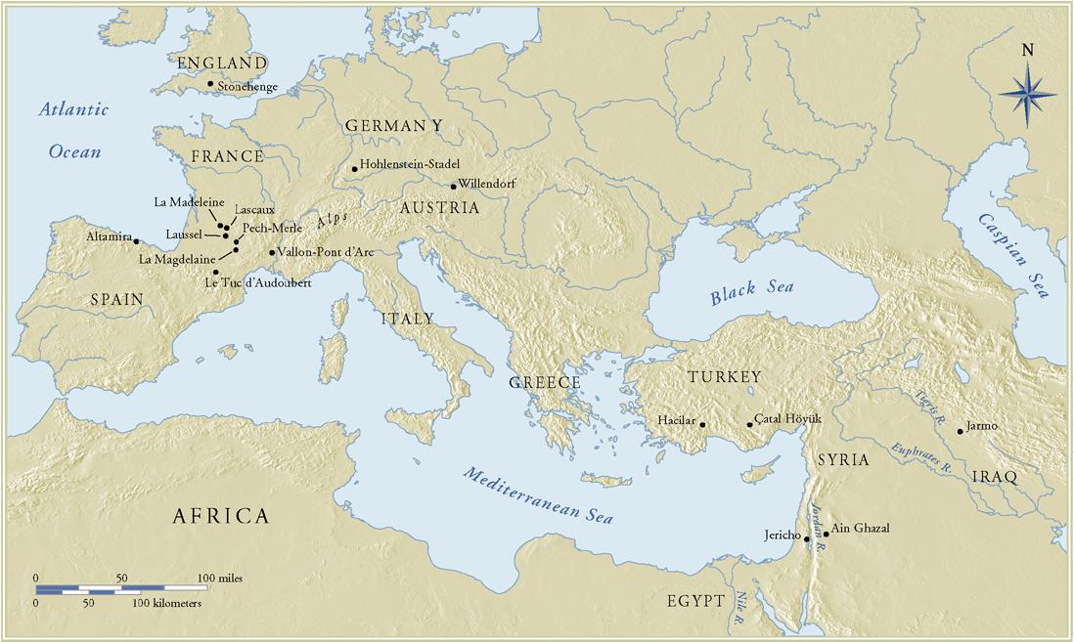
Prehistoric Europe and the Near East
Notes:
Lascaux is circled in red

Slide 3
Hall of Bulls Lascaux
Notes:
Lascaux Cave- Has the best known cave paintings
Paintings were found in 1940 in the Dordogne region of southern France
It was a very popular tourist site when opened to the public after World War II
Closed in 1963 to combat the effects of a fungus brought on by Heat, humidity, exhaled carbon dioxide and other contaminates brought by visitors
Lascaux has around 600 Paintings and 1,500 engravings
The cave has good acoustics and would have made a good area for many rituals to take place

Slide 4
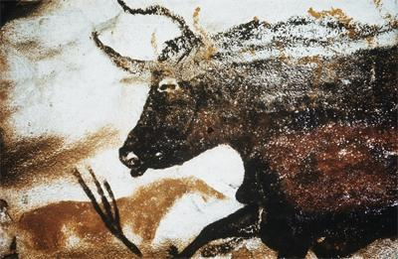
Lascaux
Lascaux Cave- Has the best known cave paintings
Paintings were found in 1940 in the Dordogne region of southern France
It was a very popular tourist site when opened to the public after World War II
Closed in 1963 to combat the effects of a fungus brought on by Heat, humidity, exhaled carbon dioxide and other contaminates brought by visitors

Slide 5
Lascaux
Lascaux has around 600 Paintings and 1,500 engravings
The cave has good acoustics and would have made a good area for many rituals to take place

Slide 6
Great Hall of the Bulls
Two of the most basic approaches to drawing and painting that have been seen throughout art history are the outline and the silhouette.
Looking at our detail we can see both side by side
Notes:
Two of the most basic approaches to drawing and painting that have been seen throughout art history are the outline and the silhouette.
Looking at our detail we can see both side by side
Overlapping of figures in the Lascaux cave were probably painted over time and not the work of one individual

Slide 7
Great Hall of the Bulls
Overlapping of figures in the Lascaux cave were probably painted over time and not the work of one individual
Notes:
Two of the most basic approaches to drawing and painting that have been seen throughout art history are the outline and the silhouette.
Looking at our detail we can see both side by side
Overlapping of figures in the Lascaux cave were probably painted over time and not the work of one individual

Slide 8
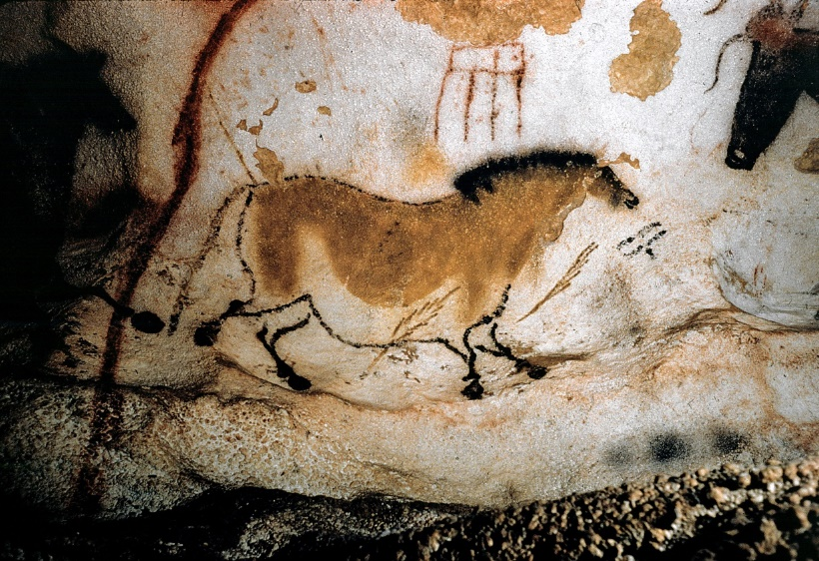
Lascaux
Many animals are depicted on the cave walls; cows, bulls, horses, deer
Why do you think we call this the “Chinese Horse”?
Do you think this horse is running?
Figure 1-12A “Chinese horse,” detail of the left wall in the Axial Gallery of the cave at Lascaux, France, ca. 15,000–13,000 BCE. Horse, 4’ 11” long.
Notes:
Many animals are depicted on the cave walls; cows, bulls, horses, deer
Why do you think we call this the “Chinese Horse”?
Do you think this horse is running?

Slide 9
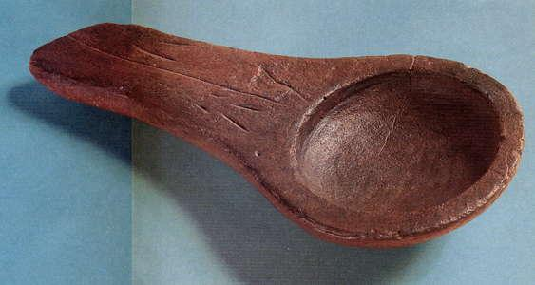
Lascaux
Over 100 small lamps have been found in the cave at Lascaux.
What could those lamps have been used for?
Notes:
Over 100 small lamps have been found in the cave at Lascaux.
What could those lamps have been used for?

Slide 10
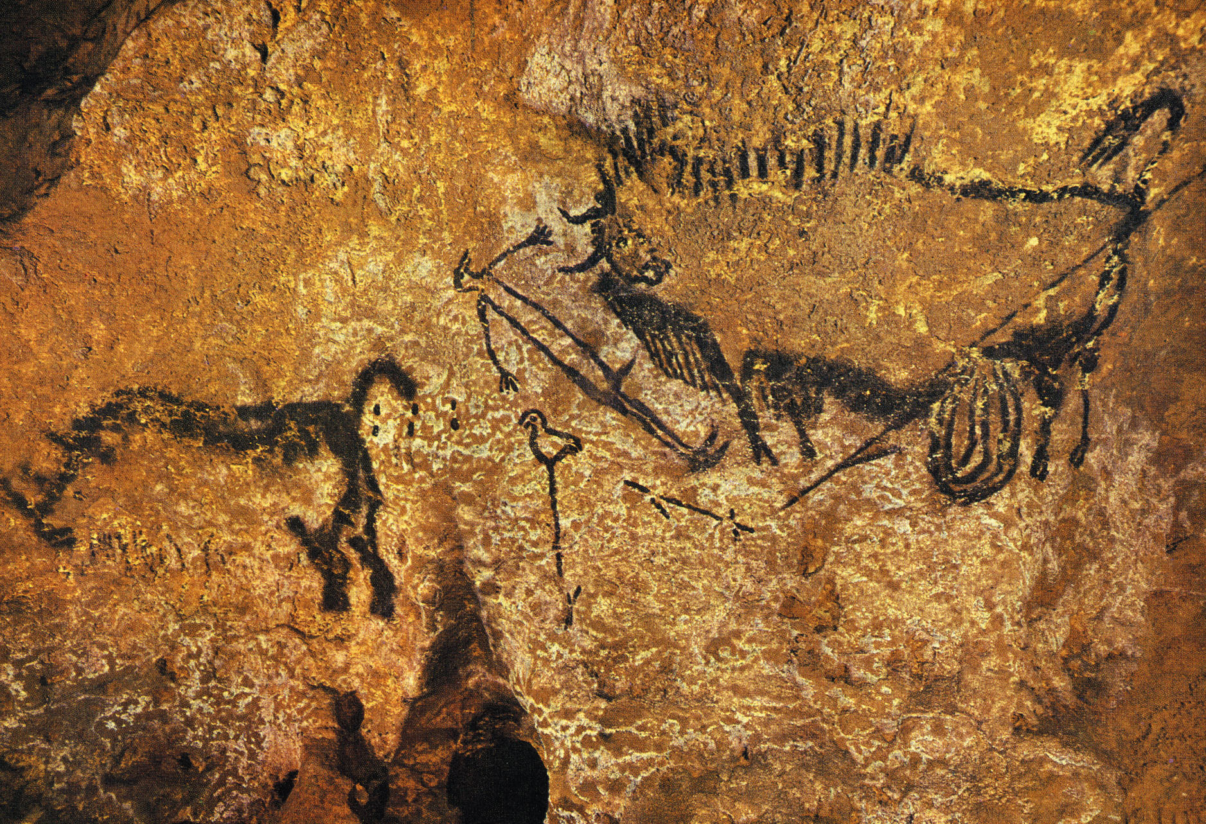
Figure 1-12 Rhinoceros, wounded man, and disemboweled bison, painting in the well of the cave at Lascaux, France ca. 15,000 – 13,000 BCE. Bison 3’ 8” long.
Notes:
In Western thought we have the tendency to look at images that are adjacent to each other on a surface as forming a narrative
We have no way of knowing if a narrative is in view here. There are many possibilities to what the images mean a couple ideas are; 1.) they truly make a narrative, 2.) They were drawn or painted at separate times and coincidentally coincide with each other in our Western idea of the picture plane.

Slide 11
Figure 1-12 Rhinoceros, wounded man, and disemboweled bison, painting in the well of the cave at Lascaux, France ca. 15,000 – 13,000 BCE. Bison 3’ 8” long.
Notes:
In Western thought we have the tendency to look at images that are adjacent to each other on a surface as forming a narrative
We have no way of knowing if a narrative is in view here. There are many possibilities to what the images mean a couple ideas are; 1.) they truly make a narrative, 2.) They were drawn or painted at separate times and coincidentally coincide with each other on our Western idea of the picture plane.

Slide 12
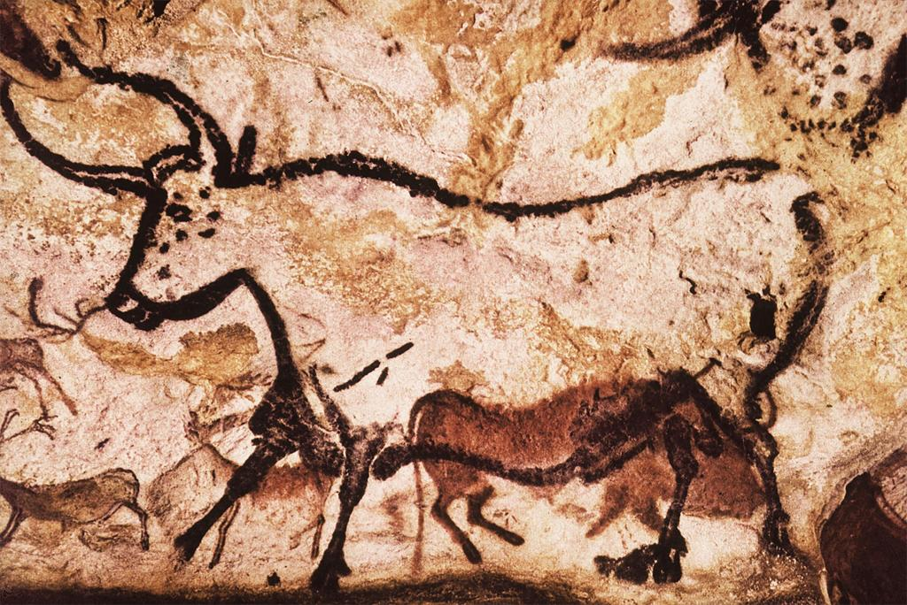
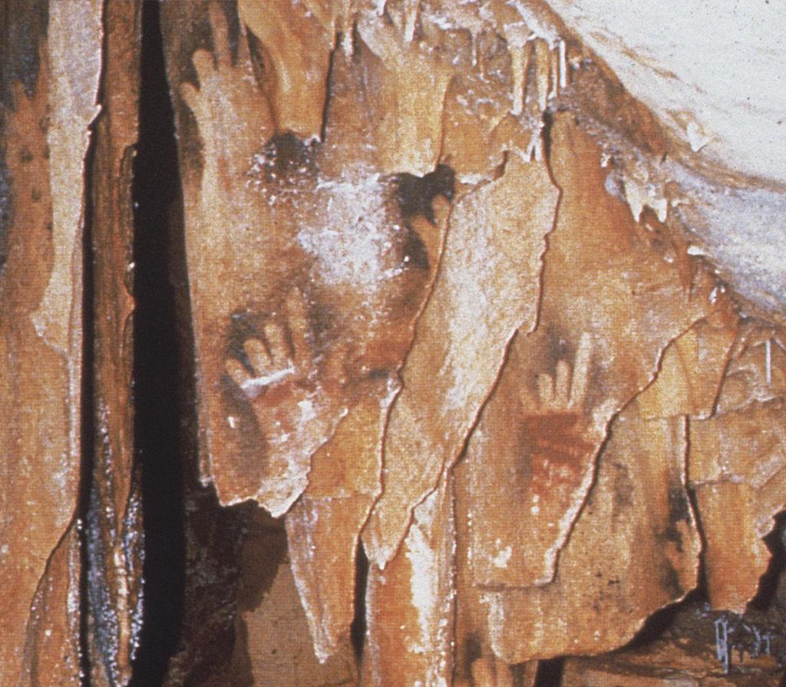

Slide 13
Cave Art of France and Spain
Many of the European caves containing prehistoric are fall into the geographic area of Northeastern Spain or Southern France
Notes:
Many of the European caves containing prehistoric are fall into the geographic area of Northeastern Spain or Southern France

Slide 14
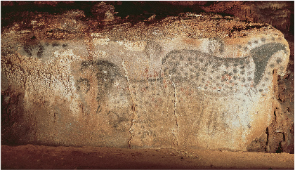
Figure 1-10 Spotted horses and negative hand imprints, wall painting in the cave at Pech-Merle, France, ca. 22,000 BCE. 11’ 2” long.

Slide 15
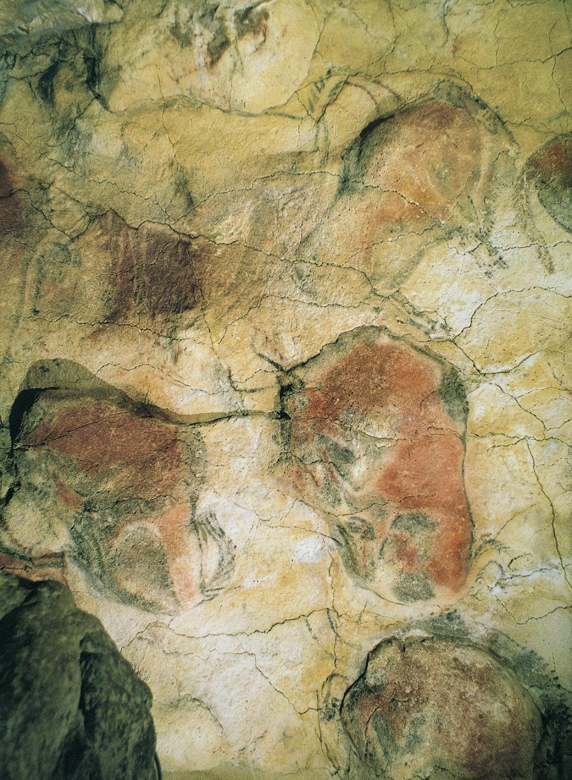
Figure 1-9 Bison, detail of a painted ceiling in the cave at Altamira, Spain, ca. 12,000–11,000 BCE. Each bison 5’ long.
Lascaux
The ceilings of the cave were painted
Notes:
The ceilings of the cave were painted

Slide 16
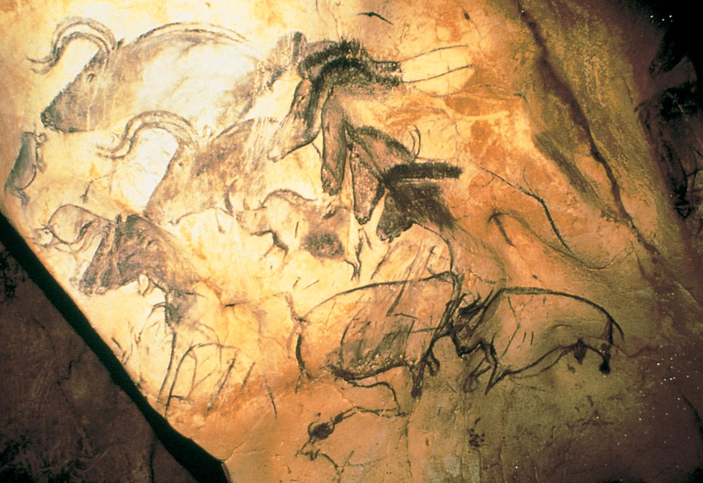
Figure 1-11 Aurochs, horses, and rhinoceroses, wall painting in Chauvet Cave, Vallon-Pont-d’Arc, France, ca. 30,000–28,000 or ca. 15,000–13,000 BCE.

Slide 17
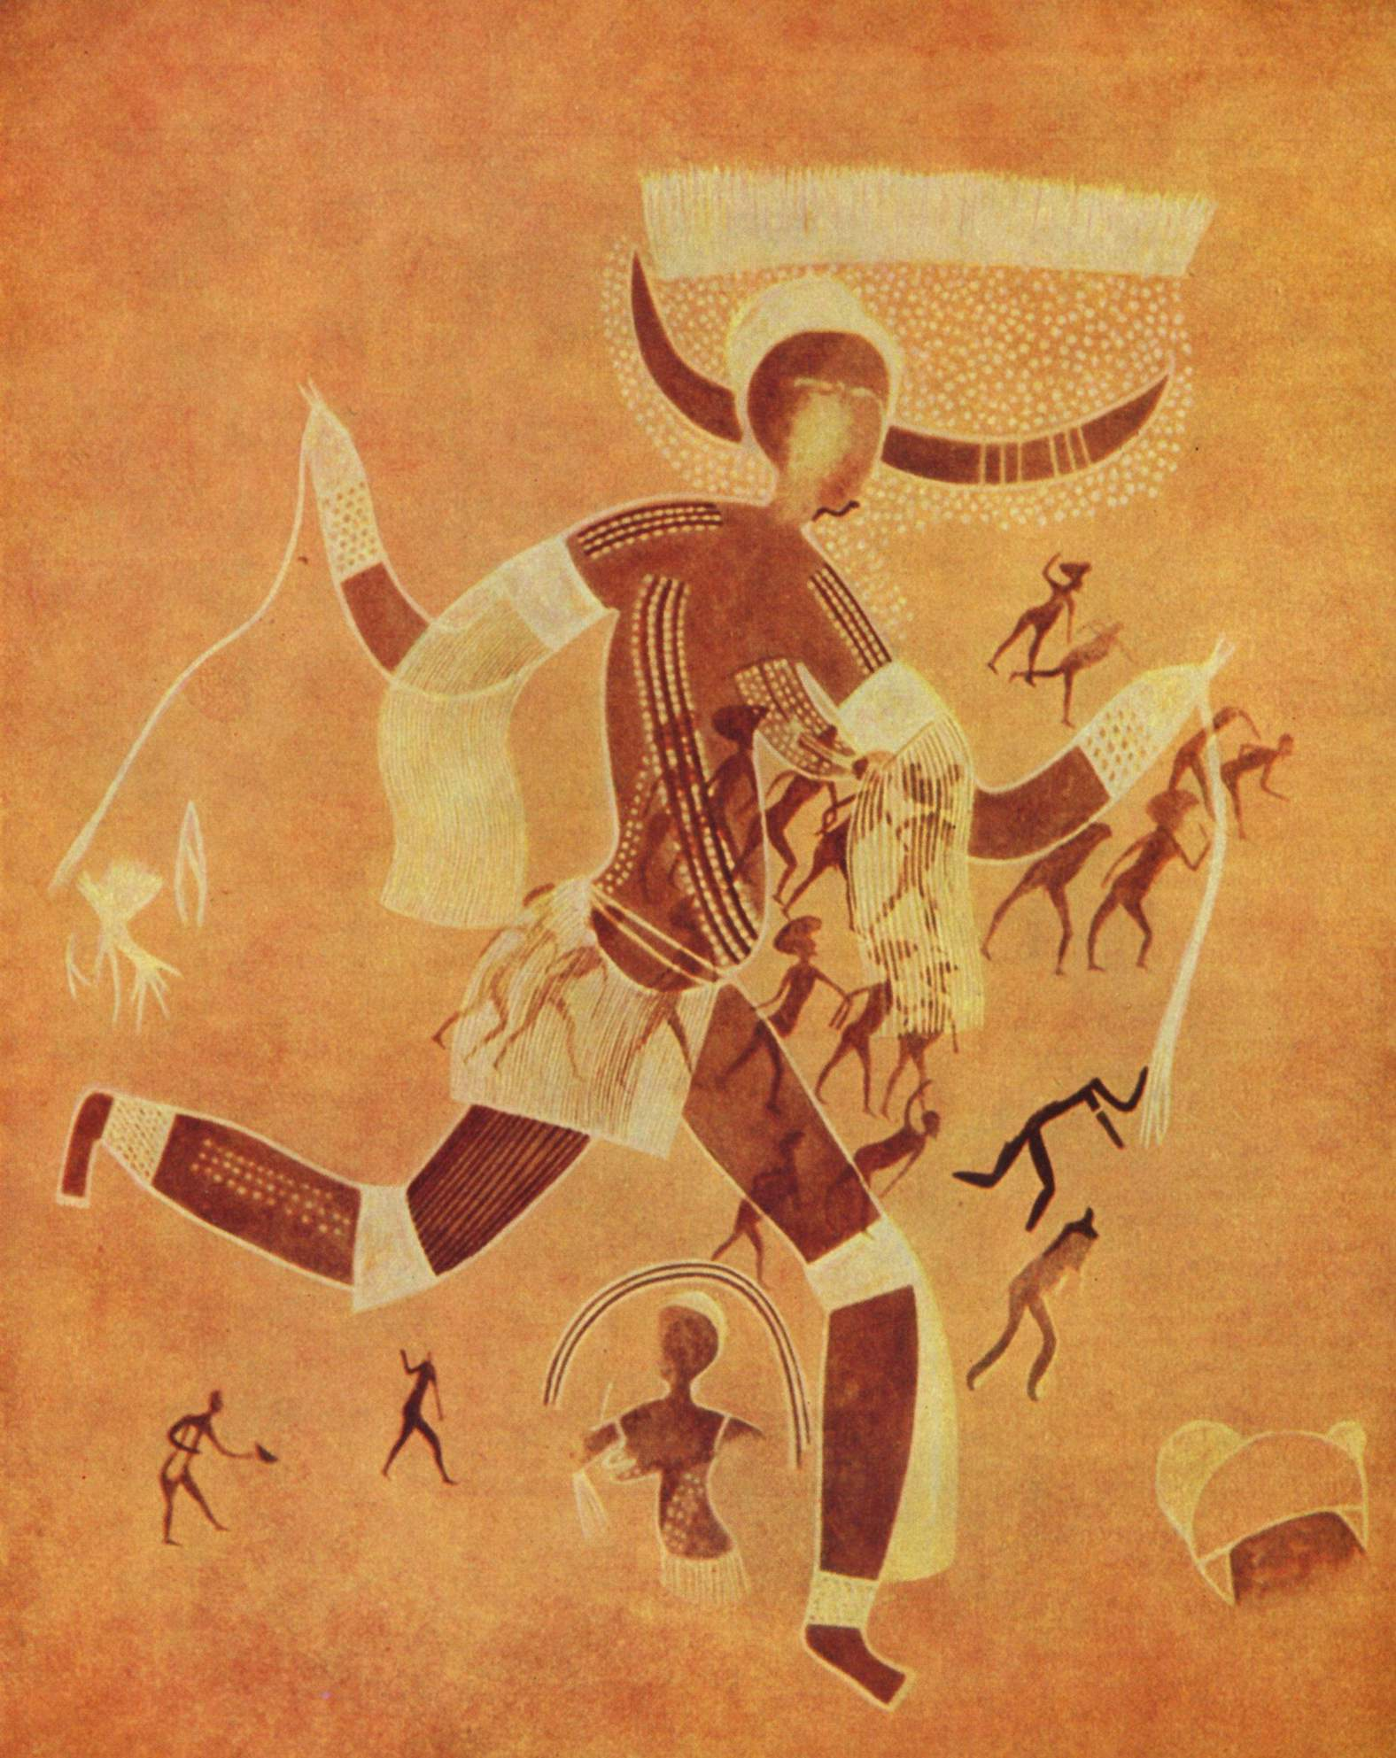
Running Horned Woman
Notes:
Prehistoric art exists all over the world. This image was found in Algeria
Many of the same objects and media are being used at the same time in Africa as in Europe; stone/wood carving, painting etc.
It is thought to be 7000 years old and a fine example of rock art
The image depicts a woman running
Notice the detail and movement
The dotted marks probably indicate that she is wearing body paint applied for a ritual
The face is featureless a common trait in early prehistoric objects
The white parallel patterns attached to arms and waist probably indicate that she is wearing a raffia skirt
The figure is portrayed in composite view showing both frontal and profile features
The image was painted over a field other much smaller human beings
This makes dating of the image much harder because the other figures were painted at another time
We have no way of knowing if the artist intended a narrative

Slide 18
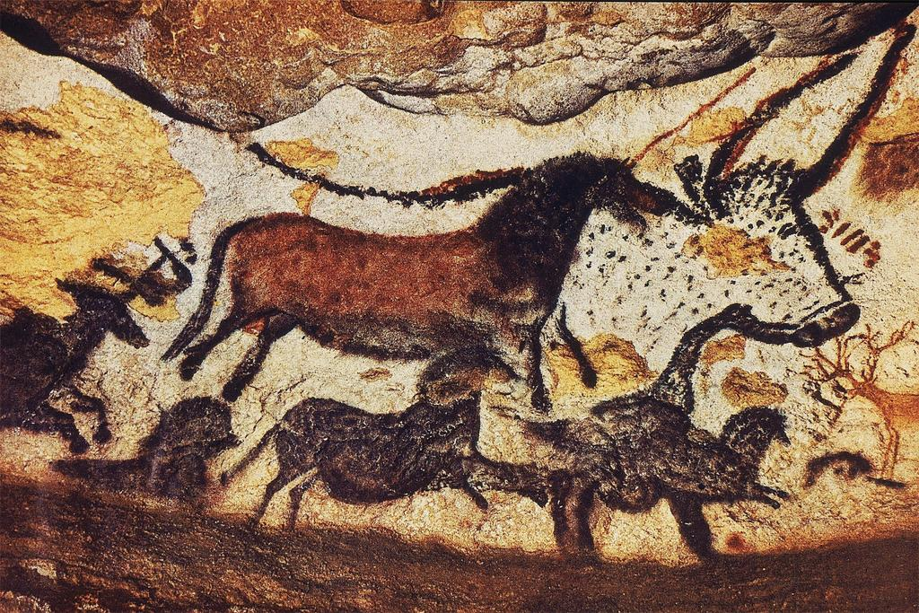
Lascaux
Detail in the Great Hall of Bulls, Lascaux
Prehistoric art exists all over the world. This image was found in Algeria
Many of the same objects and media are being used at the same time in Africa as in Europe; stone/wood carving, painting etc.
It is thought to be 7000 years old and a fine example of rock art
The image depicts a woman running
Running Horned Woman
Notes:
Prehistoric art exists all over the world. This image was found in Algeria
Many of the same objects and media are being used at the same time in Africa as in Europe; stone/wood carving, painting etc.
It is thought to be 7000 years old and a fine example of rock art
The image depicts a woman running
Notice the detail and movement
The dotted marks probably indicate that she is wearing body paint applied for a ritual
The face is featureless a common trait in early prehistoric objects
The white parallel patterns attached to arms and waist probably indicate that she is wearing a raffia skirt
The figure is portrayed in composite view showing both frontal and profile features
The image was painted over a field other much smaller human beings
This makes dating of the image much harder because the other figures were painted at another time
We have no way of knowing if the artist intended a narrative

Slide 19
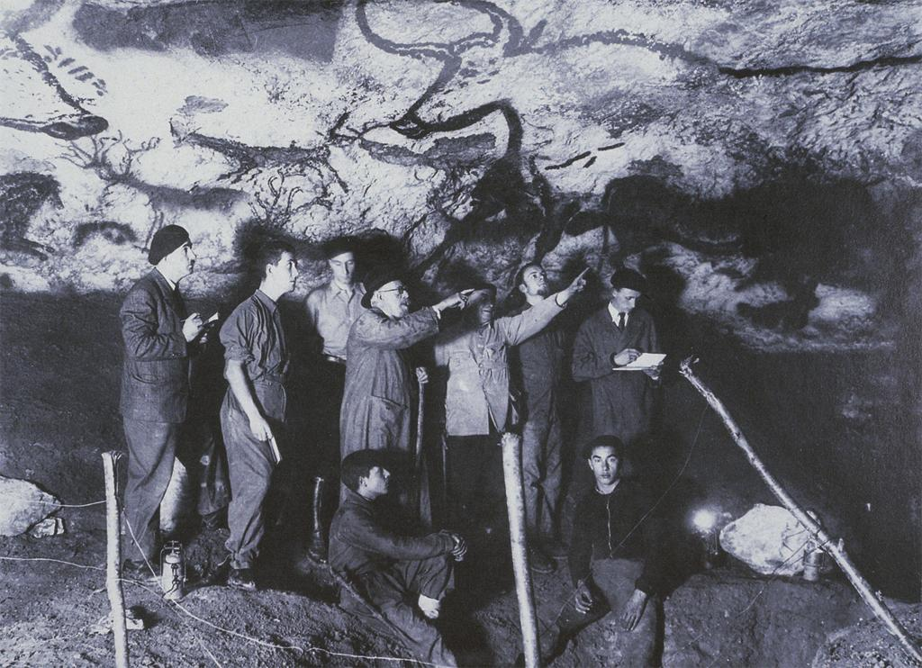

Slide 20
Vocabulary
Narrative- The components of the art object tell a story
Composite view (pose)- A convention of representation in which part of a figure is shown in profile and another part of the same figure is shown frontally; also called twisted perspective.
Mural – Wall paintings
Outline – objects drawn with an outer representational enclosing line only
Silhouette- the dark shape of an object or figure visible against a lighter background, especially in dim light.
Prehistoric Cave Art
Lascaux
Notes:
Narrative- The components of the art object tell a story
Composite view (pose)- A convention of representation in which part of a figure is shown in profile and another part of the same figure is shown frontally; also called twisted perspective.
Mural – Wall paintings
Outline – objects drawn with an outer representational enclosing line only
Silhouette- the dark shape of an object or figure visible against a lighter background, especially in dim light.

Slide 21
http://lascaux.culture.fr/

