Slide 1
Steampunk

Slide 2
Steampunk
Steampunk
Steampunk refers to a subgenre of science fiction and sometimes fantasy that incorporates technology and aesthetic designs inspired by 19th-century industrial steam-powered machinery.
https://en.wikipedia.org/wiki/Steampunk
Steampunk refers to a subgenre of science fiction and sometimes fantasy that incorporates technology and aesthetic designs inspired by 19th-century industrial steam-powered machinery.
https://en.wikipedia.org/wiki/Steampunk

Slide 3
IN THE MOVIES

Slide 4
The Time Machine

Slide 5
A Trip to the Moon

Slide 6
Metropolis

Slide 7
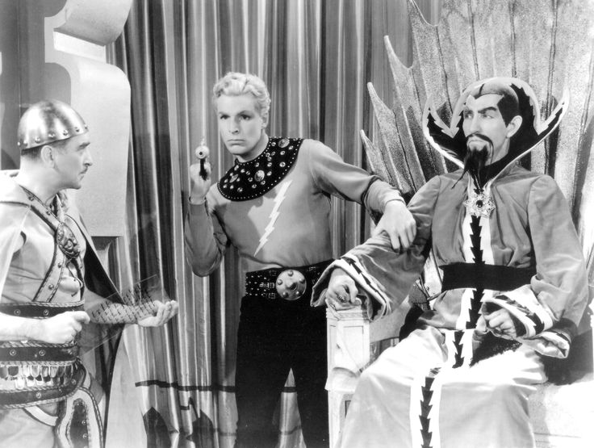
Flash Gordon

Slide 8
Sleepy Hollow

Slide 9
Wild Wild West

Slide 10
Sky Captain

Slide 11
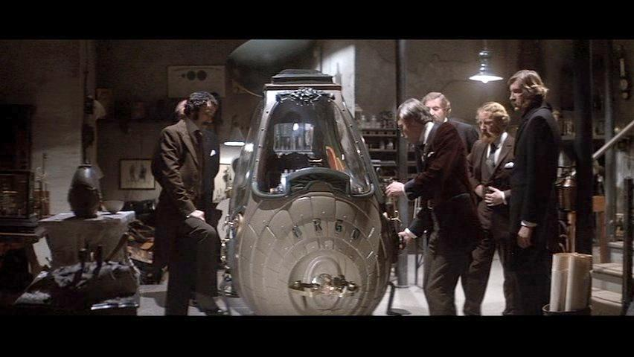
Time After Time

Slide 12
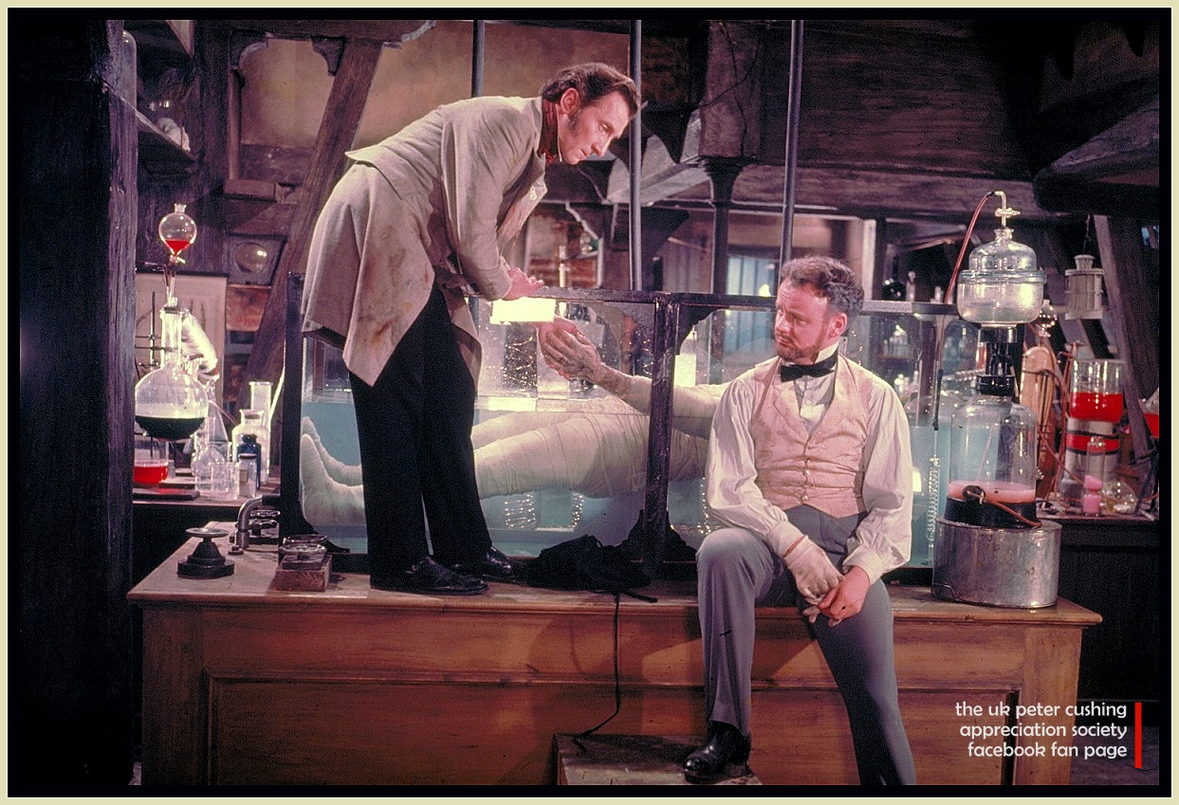
Dr. Frankenstein

Slide 13
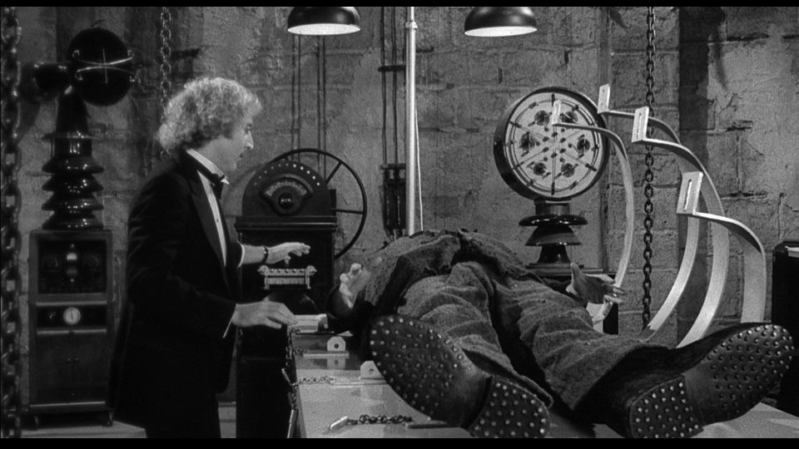
Young Frankenstein

Slide 14
Star Wars

Slide 15
Steampunk Art
https://www.google.com/search?q=steampunk&espv=2&biw=1440&bih=799&source=lnms&tbm=isch&sa=X&ved=0CAYQ_AUoAWoVChMIhbn9qZfSxwIVyouSCh0IYgfW&dpr=1#tbm=isch&q=steampunk+art
https://www.google.com/search?q=old+steampunk+art&espv=2&biw=1440&bih=799&source=lnms&tbm=isch&sa=X&ved=0CAYQ_AUoAWoVChMIxNu0yp7SxwIVQ0GSCh3u3gFX#imgrc=z7VxV6Bcls-JcM%3A
https://www.google.com/search?q=museum+steampunk&biw=1440&bih=799&tbm=isch&source=lnms&sa=X&ved=0CJoBEPwFKAFqFQoTCKinn4yg0scCFQ5bkgodLYcBcw#imgdii=5Pix8UqcvgSgkM%3A%3B5Pix8UqcvgSgkM%3A%3BvXJd7X_iX9rBpM%3A&imgrc=5Pix8UqcvgSgkM%3A

