Slide 1
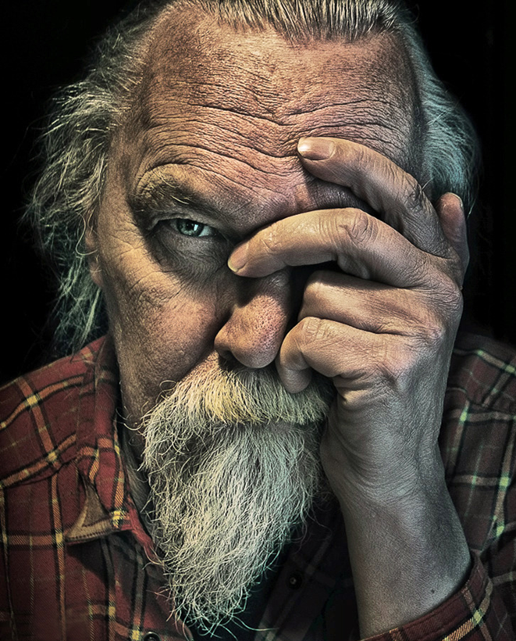
Composition: The Strongest Way of Seeing
The first impression from a photograph is determined by the strength of its subject and its immediate visual impact
Even if the subject isn’t that interesting, a strong composition will keep the viewers attention
The following techniques will help you control what the viewer sees

Slide 2
Basic Components of Composition:
Subject Placement (a place for the eye to rest. make it worth while.)
Viewpoint (be willing to experiment with various camera angles)
Background (compliments the subject)
Simplicity (keep it simple)

Slide 3
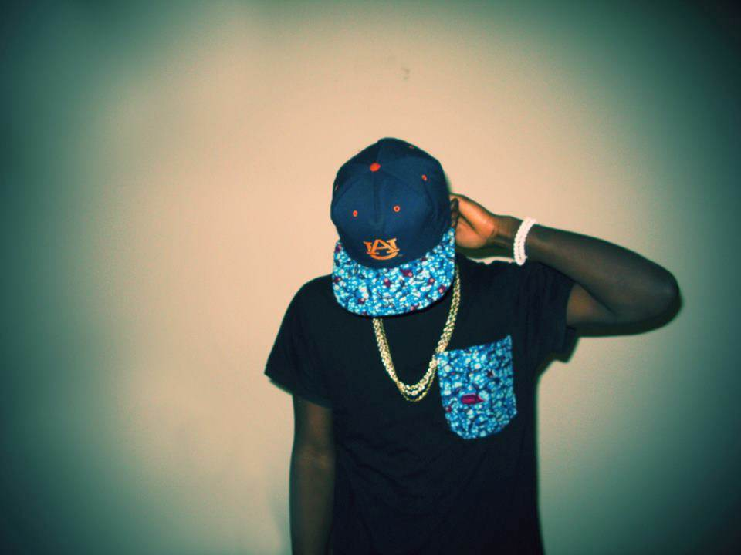
The Rule of Thirds
The human eye is attracted to movement more than any other visual element The rule of thirds creates movement, commanding the viewers attention and drawing the eye to the subject by placing the major elements of the shot slightly off center
For more tension, place subject closer to the edge of the frame
Roselyn Johnson

Slide 4
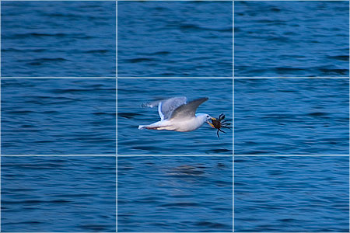
The Rule of Thirds
Without…
With…
You can set your camera to show this Grid over the viewfinder

Slide 5
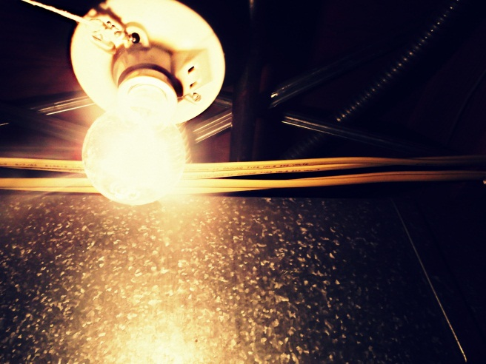
Take 6-9 Pictures of Objects in Space using the Rule of Thirds to emphasize subject …
*Background should compliment your subject. Keep it simple.
*Include the shadow if you can.
*When finished print a wallet sheet.
*Refer to grading rubric and comment on at least 3 of your shots. Turn in to me.
*Save your BEST shots for editing. You may delete the rest.

Slide 6
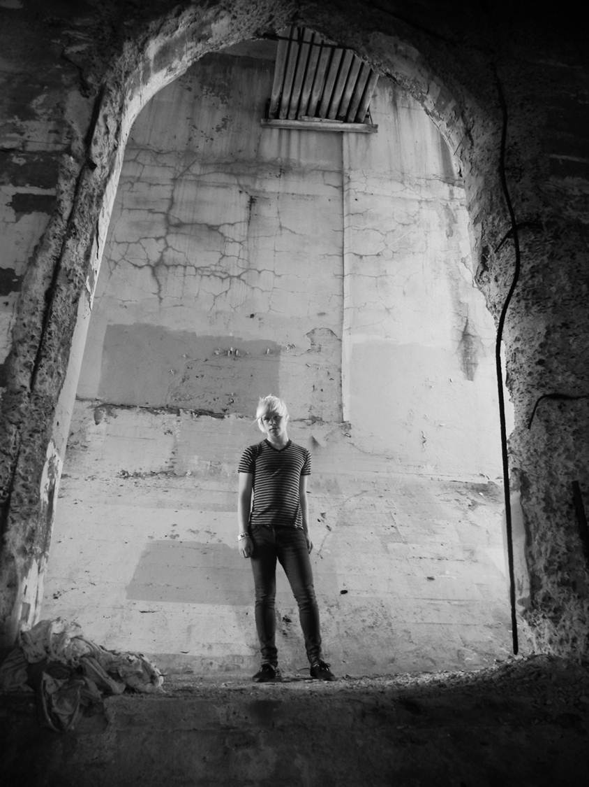
Framing…
Framing creates balance and unity by visually “gluing” the subject in place. Framing makes the photograph feel still and stable while drawing the viewers eye to the subject.
Position your camera so the subject is framed by another element in the scene; a tree branch, window, architectural details, etc…
Photograph your subject looking THRU something.
Mollie Dabill

Slide 7
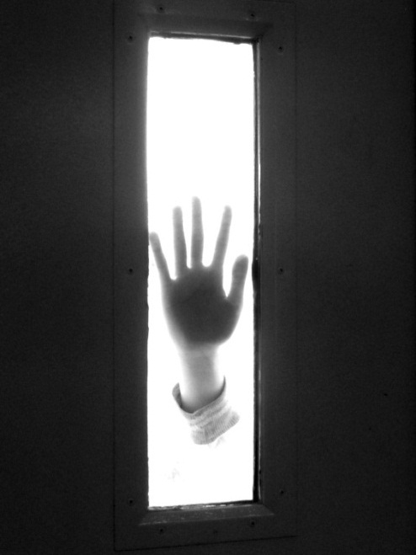
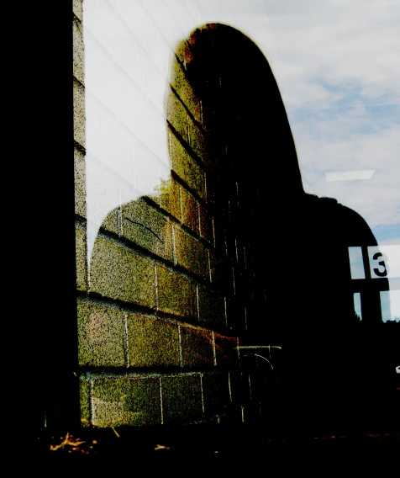
Take 6-9 pictures using Framing to emphasize subject …
Frames, hands, windows & doors
*Background should compliment your subject. Keep it simple.
*When finished print a wallet sheet.
*Refer to grading rubric and comment on at least 3 of your shots. Turn in to me.
*Save your BEST shots for editing. You may delete the rest.

Slide 8
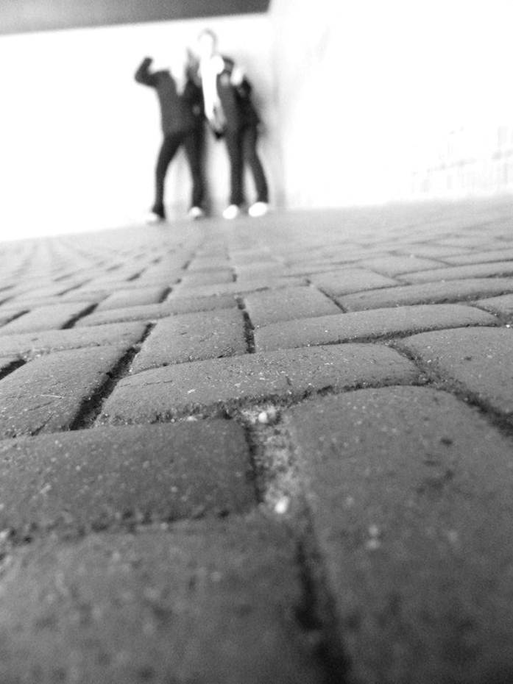
Viewpoint…
*From Above
*From Below
*Worms Eye View
*Foreshortening
Your point of view helps you find the best angle. If a photo seams flat in terms of subject matter or lighting, try changing your viewpoint.

Slide 9
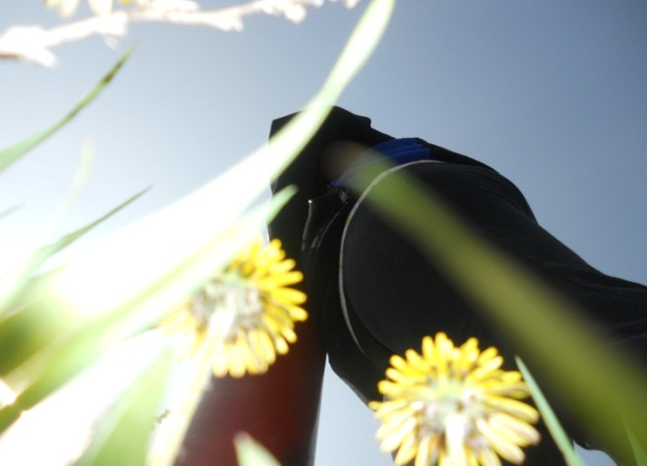
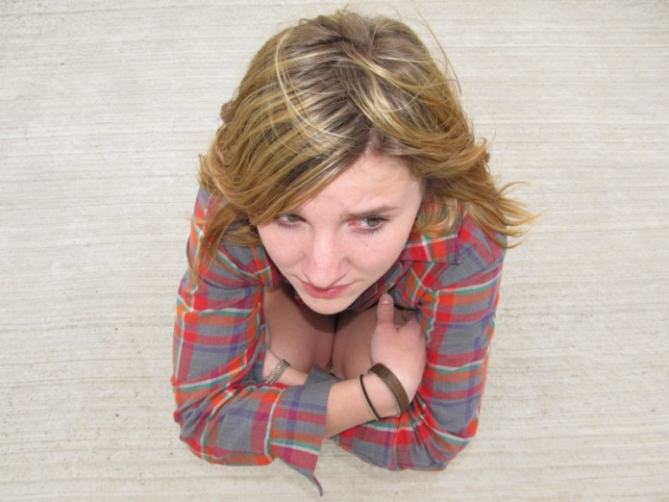
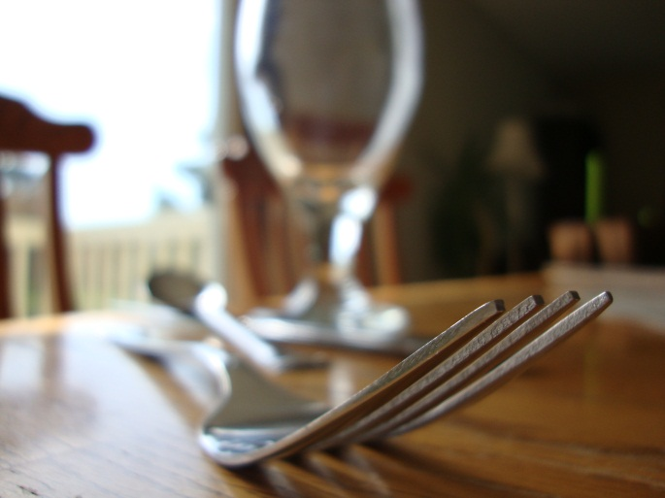
Take 6-9 pictures using Viewpoint to emphasize subject.
*Background should compliment your subject. Keep it simple.
*When finished print a wallet sheet.
*Refer to grading rubric and comment on at least 3 of your shots. Turn in to me.
*Save your BEST shots for editing. You may delete the rest.

Slide 10
Digital Photography Grading Rubric
Project Objectives:
The assignment.
What you learned and are able to do.
Composition:
Appropriate Subject.
Subject is Emphasized by Placement & Camera Angle.
Simple Complimentary Background.
Technique:
Lighting
No Backlighting, flash burn, over or under exposed, shadows included
Image Clarity
Subject is clear and in focus
Editing
Editing enhances the image
4-3: EXCEPTIONAL is for completing all of the above in a creative or original way. Photographer shows experimentation with subject(s).
3-2: PROFICIENT is for completing all of the objectives correctly. Photographers perspective of subject(s) is predictable.
2-1: INCONSISTENT is for completing some of the objectives
1-0: LIMITED an attempt was made but most project objectives show minimal effort toward project goals

Slide 11
Composition, Subjects & Technique…
Subject Ideas:
Architectural details
Hands
Shoes
Faces
Machines
Silhouette/Backlighting
Jewelry/Keys
Tree branches / Trees
Windows/Doors
Plants/Flowers
Shadows
Reflections
Textures
Patterns
Still Life (3 or more objects combined to relate)
Empty Environment
Something old
Distortions & Abstractions
Composition:
*The Rule of Thirds
*Framing
*Viewpoint:
From Above
From Below
Worms Eye View
Foreshortening
Techniques:
*Light:
hard or soft
(contrast/even)
direction
(side/front)
shadows
flash
*Exposure
*Focus
*Editing
(Photoshop, Instagram, Picmonkey etc..)

